Slide 1

bring me aiBroad
Your next adventure starts with us.
First-Generation Strength: Supporting First-Generation College Students in Study Abroad, K. Rausch 2017

Slide 2
how do we help you?
Find the perfect partner university for your goals
Get support organizing your semester — from start to finish

Slide 3
WE are the first
135,000 students studied abroad from Germany in 2018
280,716 went abroad from USA during the 2022/23 academic year
We’re here to support every one of them — at no cost.
Compatible with most websites
Scalable with Docker containers
¹https://www.spiegel.de/start/auslandssemester-was-dagegen-spricht-im-studium-
ins-ausland-zu-gehen-a-0f873cf2-9530-436d-9b4b-674b21069a7c
²https://opendoorsdata.org/annual-release/u-s-study-abroad/?utm_source=chatgpt.com

Slide 4


Slide 5

Under the Hood

Slide 6
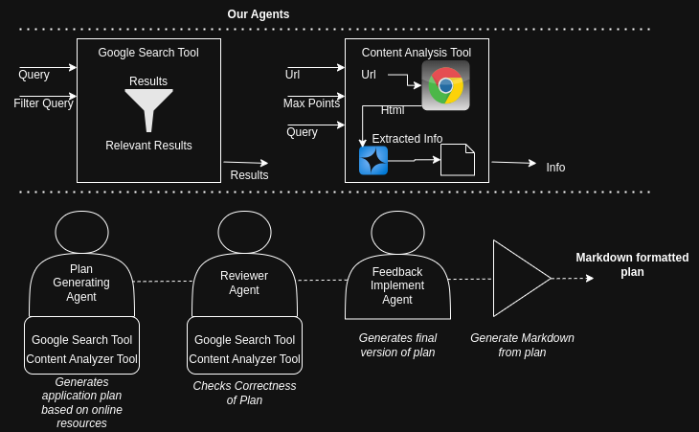
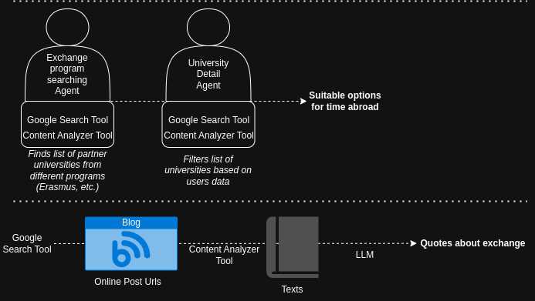
Let agents take you further - abroad

Slide 7

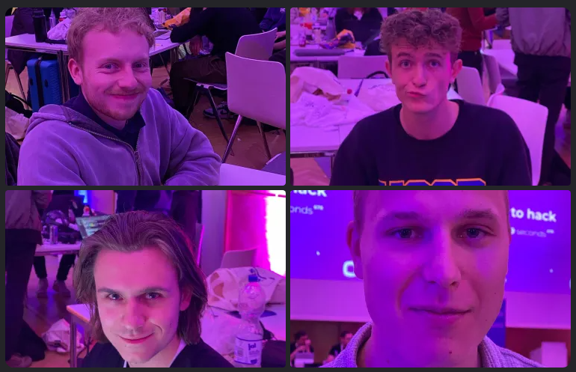
Our Team
Philipp Kathöfer
Philipp Kath
Sven Spehr
Daniel Grib
Garnett Le ✌️
Daniel Grib
Simon Hemkentokrax

